Slide 1
Painless deployments of Sitecore using Docker Swarm
Per Bering
Sebastian Winslow
April 23-24 2018
#sugcon

Slide 2
Takeaways
Ensure cross solutions reusable deployment pipelines
Increase deployment speed
Provide (close to) zero downtime related to deployments
Ease the process of deployment rollbacks
Increase the time for “actual development“
Make more of your budgets and decrease frustrations

Slide 3
Setting the scene
On the business side
IT platforms increasingly more business critical
Cost efficiency
Infrastructure
Deployments
Maintenance
Increased demands:
Experimentation and exploration
What is perceived as a commodity and given when accessing web solutions
Frequency in release cycles
On the tech side
Increasingly complex / extensive solutions
<That thing> as a Service
Separation of concern / Roles
Multiple branches and environments
Increased focus on DevOps as a discipline
Increased demands to:
Frequency in release cycles
Uptime
Flexibility
Efficiency
Interoperability

Slide 4
Typical pains
Multiple environments, budgets and foundation efficiency across solutions
CI/CD pipelines are often build from scratch or copied from previous solutions and then customized. This takes time to do, every time.
Different environments, different variables, configurations etc.
Build agents and configuration
Shared build agents typically with different Visual Studio versions, node versions, nuget versions, coverage tools, PowerShell, .NET Framework and SDK's installed, becomes more and more difficult to maintain over time.
Downtime during deployment and Infrastructure management
Following best practices of Sitecore deployment
Time consuming and costly to create deployments without downtime, mostly due to differences in each solution, load balancers, on-prem servers and Azure App Services.
The need of service windows
The possibility of and time consumed by troubleshooting

Slide 5
Typical pains
Deployment time
You often produce large build artifacts with many files that not necessarily belong to the solution but to the Sitecore version you are running on. All of this needs to be copied every time we deploy.
Large artifacts and many files takes time to deploy, often many minutes per instance on on-prem servers and even longer on Azure App Services.
Scaling of the platform
Adding more resources to the solution in terms of servers can often be time consuming and/or costly
Major feature developments or extra ad-hoc environments
In multi-development unit setups with multiple branches/features, it is quite common that the need/desire for testing specific branches isolated present itself. This is often cumbersome and dependent on / blocking environments already in use.

Slide 6
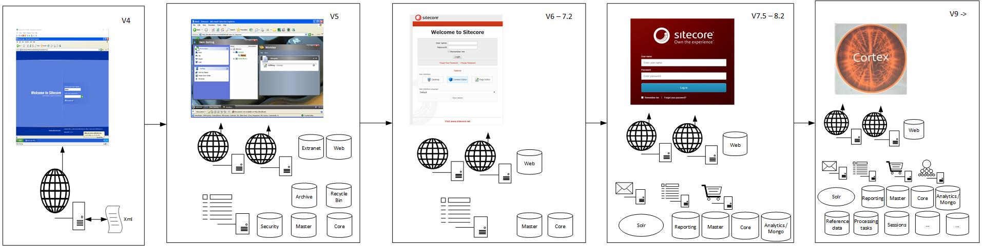
Evolution

Slide 7
Container Orchestration
Declarative service model
Everything including desired state, is defined in versioned files, for example docker-compose files.
Rolling updates:
Updates can be applied in parallel with the running containers.
Service discovery and load balancing:
DNS based discovery, reference for example sql, mongo or solr servers by service name instead of server name / IP, reduces configuration management and ensures portability.
Self-healing:
Containers are kept running and automatically restarted in case of failure, moved to a healthy host in case of server errors or update. It will try its best to keep the desired state of each service.
Secrets and configuration management:
Provides a place for, for example SSL certificates or other configuration that can be referenced from your services.

Slide 8
Why use Docker Swarm
Built into the Docker engine and cli
Most mature Windows support right now, compared to:
Kubernetes: Just moved from experimental to beta! Hopefully stable as part of the 2.0 release in the summer.
Rancher: Experimental
Apache Mesos: Experimental
Use both Windows and Linux containers together
Also supported and documented by Microsoft since Docker Enterprise Edition was added to Windows Server 2016, for free
Easy to get up and running with docker swarm init and docker swarm join, no other moving parts
Notes:
Kubernetes is very popular right now and could be the platform to use with Windows containers in the future. All major cloud providers has support and it's massively invested in by also Microsoft, both on the Azure front with ACS (Azure Container Services) and AKS (Azure Kubernetes Services), but also with Visual Studio and "VS Connected Environments". Even Docker for Windows and Mac now supports running Kubernetes out-of-the-box.

Slide 9
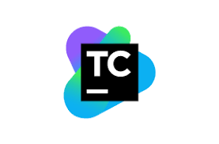


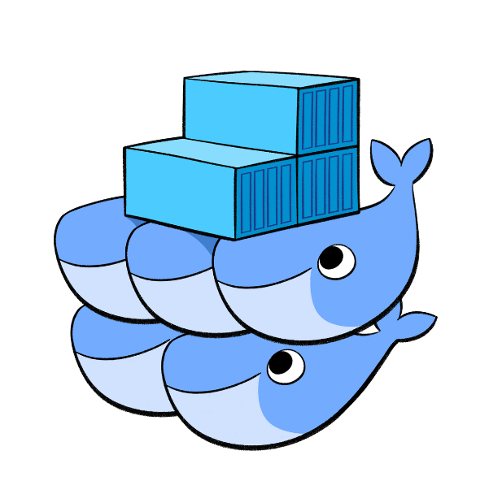
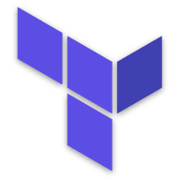
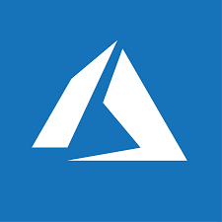
Tooling
Docker / Docker Swarm
Azure
Terraform
Sitecore
TeamCity
SQL
Solr
Nginx
Grafana
InfluxDb
…

Slide 10
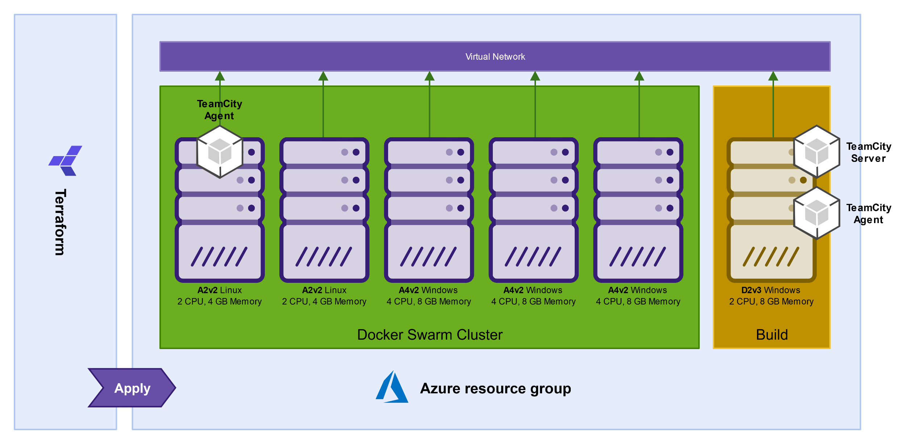
Wonderland – the infrastructure

Slide 11
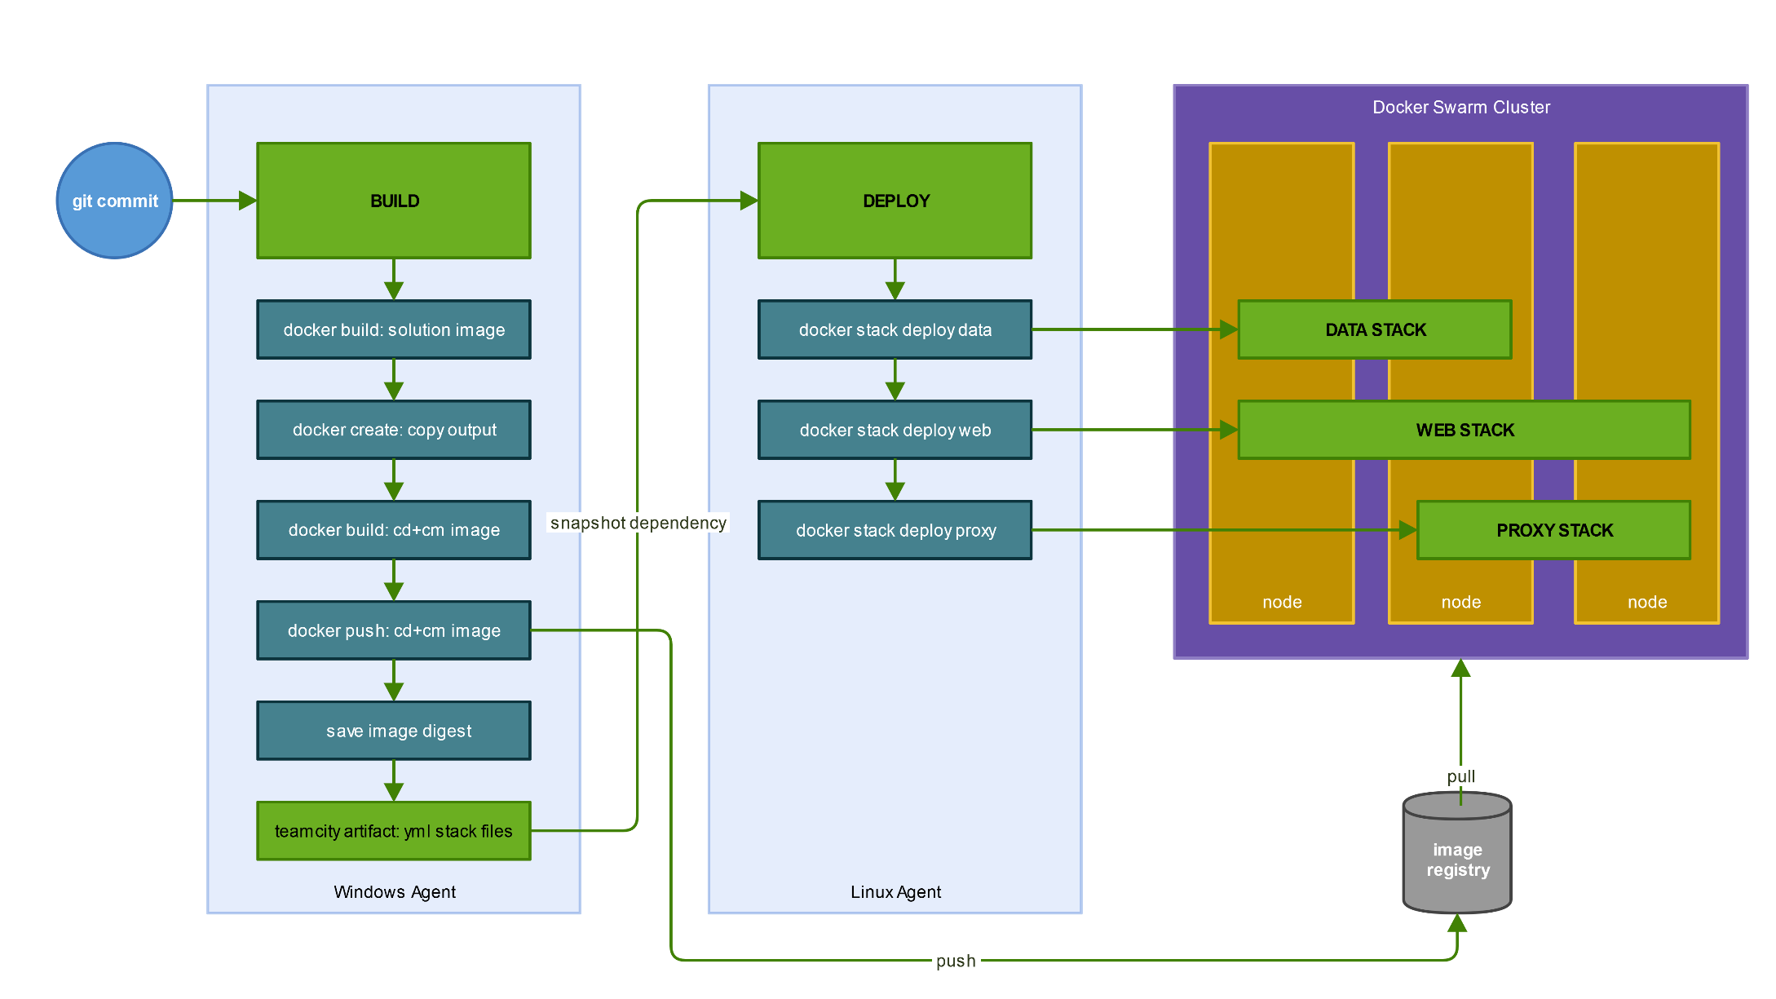
The CI / CD magic
Notes:
Build: 5 Docker kommandoer – en linje pr. kommando
Deploy: 3 Docker kommandoer – hvilket faktisk allerede er optimeret til kun 2 kommandoer (1 linje pr. stack der deployes)

Slide 12
Scenarios
The following three scenarios are going to help us walk the talk:
Code change
Stack change / Scaling
Deploy new branch / new environment

Slide 13
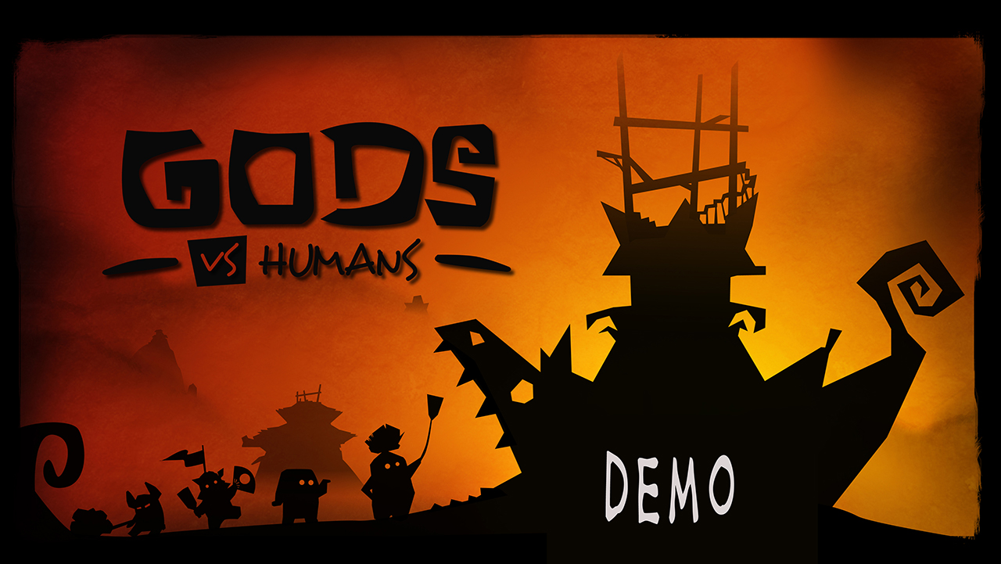

Slide 14

Q&A
Depending on your questions we might resort to any of the following strategies

Slide 15
Thanks
Special thanks should be given to
Jesper Balle a great colleague of ours for feedback and inspiration
The SUGCON 2018 team, Sitecore and all the other speakers to make this event happen
Valtech for being a great company to work in with room and inspiration for doing AND using cool stuff like this
But first and foremost of course to….

Slide 16
Thank you!
Per Bering @pbering per.bering@valtech.com
Sebastian Winslow sebastian.winslow@valtech.com

